Slide 1


Australia & New Zealand
Artificial Intelligence Led.
Human Intelligence Perfected.

Slide 2




Australia and New Zealand
AI first organization using AI in services we deliver, our business operations, decision making and embedded in our solutions
Working with clients across Banking, Insurance, Financial Services Retail, Higher Education and Professional Services
Focus on Customer Engagement, Data, AI & Automation
Presence in all major cities across Australia & New Zealand
Brisbane
Perth
Adelaide
Sydney
250+
Melbourne
Auckland
Headquarters
Wellington
Delivery Centers
Consultants working for the region
Our Service Offerings
15+
Build
Optimize
Transform
Run
years in the region
Design, build, and market digital products, platforms, and applications that create the experiences your customers want
Enhance business outcomes through process optimization
Achieve digital transformation and modernization at speed and scale with actionable insights
Boost efficiency and lower costs across your IT landscape
30+
Our Intellectual Properties and Experience driving growth in ANZ
Active Clients
Speed and Steady your product, platform, processes and data journey to Cloud
Automate your essential processes to increase quality & efficiency
Create direct, tailored path for your teams to develop against any need
We service ANZ enterprises from near shore & Global Capability Centers

Slide 3









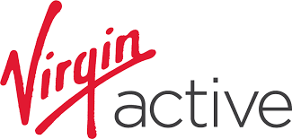














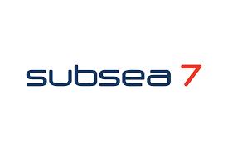







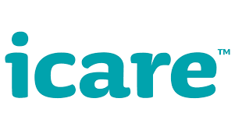

Creating Smiles for Our Customers
We provide tailored solutions to 30+ clients in Australia & New Zealand, counting some of the best firms in the ASX Top 200

Slide 4










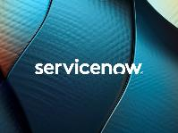





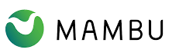







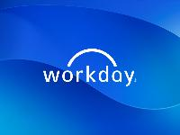
Creating Smiles With Our Partners
Strategic Partners
Significant investment, focused on sales and marketing
Vertical-focused Partners
Deep domain expertise with sector-specific technologies
Next-level Partners
Strong suite of industry-leading enterprise solutions

Slide 5
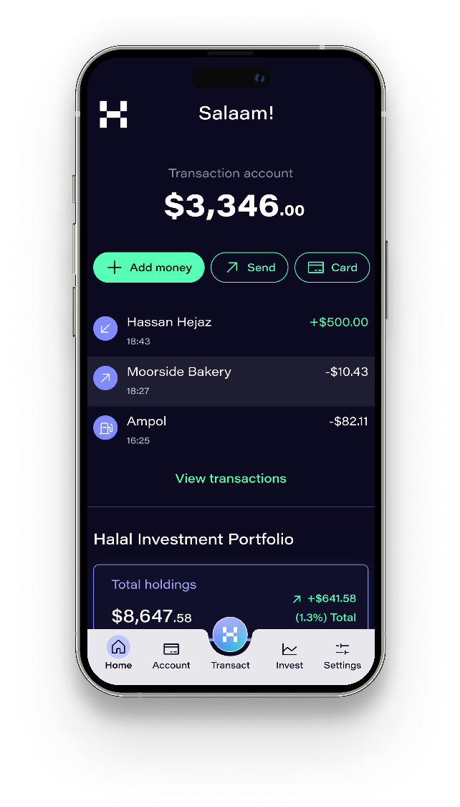

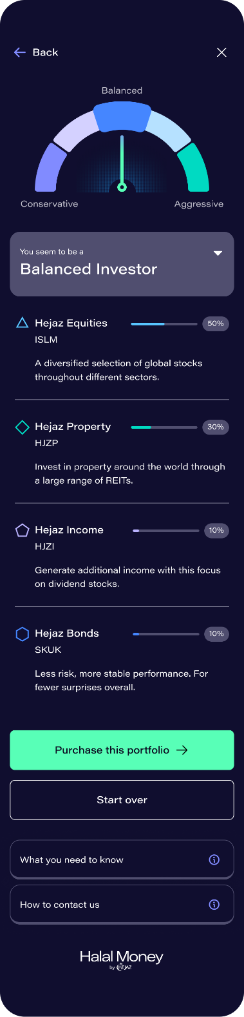
Building an innovative platform providing easy access to Shariah compliant banking
Banking – Biggest Islamic Banking and financial services provider in Australia
Australian Muslims lacked options for storing, investing and growing their wealth, lack of financial assistance, Halal investments, Halal loans, ability to support Islamic organizations and quality of products available.
Hejaz Islamic Financial Services Pvt Ltd partnered with Hexaware to build the Halal Money App over a period of 15 months from ideation to the MVP launch with the vision of creating a tech platform and digital distribution channel that makes halal financing more accessible.
Coupled with our digital product engineering services, we brought together a coalition of product partners for the Transaction account, ETF trading, Term investments, Cloud services, e-KYC, AML/CTF, Customer servicing platform to enable a fully serviceable operating model from day 1 of the go-live.
SERVICES OFFERED AS PART OF THE ENGAGEMENT
Digital Strategy, Ops & Organisation
Architecture Strategy
Experience Design
App Development
Product Strategy
1st
World’s first Islamic Banking Unicorn

Slide 6

Store Operations Redefined: Operational Efficiency / Proactive Maintenance / Asset Intelligence
Retail – Australian leading Supermarket chain
Hexaware implemented a futuristic solution for Energy and Building management services for the store and helped in predictive maintenance, energy optimization, and food safety.
Digital channels to engage with business, cloud-based asset management platform and 24x7 auto-ticket creation.
Manage a proactive and preventive maintenance plan to reduce MTBF impacting direct and indirect cost of failure.
Integrate IoT feed from in-store assets and leverage ML to create fault detection and predictive maintenance models across their lifecycle.
Proactive maintenance alerts triggered based on analytics and asset intelligence.
21%
64%
40%
18%
Increase in TCO Benefit
Improved Efficiency
Increased Quality of Service
Reduced Maintenance Cost

Slide 7

Modernizing Existing Systems Using Digital Cloud Platforms
Banking – One of the largest Non-Bank Lenders in the ANZ region
Omnichannel Loan and Mortgage Computation Intake: Designed and deployed DM, PAF, and UCP systems to streamline the intake process, managing applicant information, assets, costs, and more.
Automated Client Data Gathering: Enhanced efficiency and effectiveness by automating the collection of client data.
White-Labeled Solutions: Automated document uploads and performed ABN lookups to ensure seamless integration and branding.
Data Integration: Integrated an enterprise data warehouse with OutSystems for secure storage and retrieval of critical consumer data.
Application Modernization: Digitized and modernized applications, reducing overheads and maintenance.
Automated Initial Client Data Requests: Streamlined the initial data request process for financial decision-making and advisory services.
Workflow Optimization: Implemented new forms in OutSystems, making workflows smoother and more user-friendly.
50%
90%
1
Less time for decisioning
Faster delivery and greater agility
single portal for loans

Slide 8
Banking Operations with Reduced risk, Enhanced security and improved Operational efficiency
Banking – APRA regulated Bank in Australia and New Zealand
Provided managed services with stringent service levels, improved user onboarding/offboarding, and built a robust procedures repository to reduce single points of failure.
Deployed Intune and MS Teams, implemented AWS helpdesk IVR, and upgraded core banking systems from Power 8 to Power 10.
Mitigated network risks, conducted regulatory compliance audits, added ISP redundancy with Mega port, and aggregated network links for better control.
Automated core banking subsystems, implemented asset lifecycle management, and managed ITSM tools, resulting in cost savings.
Customized solutions to improve SD CSAT scores and enhanced network performance by reducing ISP dependency.
Scope Managed: Active AD accounts and business applications, on-premise infrastructure including virtualized servers, workstations, iOS devices, and core banking systems. Security infrastructure with advanced firewalls and SIEM statistics. Cloud presence with Azure subscriptions, O365 services, AWS for internet banking and API gateway, and multiple SaaS vendor-managed environments.
90%
99%+
CSAT
Applications Uptime

Slide 9
Enhancing Operational Efficiency and Innovation in Application Support
Insurance – One of the largest private health insurers in Australia and New Zealand
Operational Efficiency & Cost Optimization by automating routine tasks and optimizing resource allocation using data analytics thus leading to cost reductions and improved overall efficiency
24/7 Availability & Rapid Response using advanced monitoring tools to detect and address issues proactively, ensuring minimal downtime and high application availability.
Proactive Issue Management including regular system audits, predictive maintenance, and AI-driven analytics to identify potential problems before they occurred and a robust root cause analysis (RCA) process.
Scalability & Flexibility by designing with scalability and flexibility in mind, utilizing cloud-based infrastructure and modular architecture.
Continuous Improvement & Innovation through regular training and cross-skilling of team members. Creative problem-solving was encouraged, and feedback loops were implemented to learn from past experiences. Initiatives like the Brainbox project helped reduce defects and drive year-over-year savings, while automation-backed ticket resolution and knowledge management practices further enhanced operational performance.
99%+
<1%
Change Success Rate
Systems downtime duration

Slide 10

Fostering Innovation and Streamlining Efficiency, delivering complete peace of mind
Professional Services – Leading Assurance and Standards Business Services Company
Query Automation Tool: Hexaware developed automation tool to reduce time taken in scanning all URL present for Codes of Practice and generate Report. This helped to reduce great amount of manual effort in searching queries and thus increasing efficiency and reducing cost.
Search Term Automation: Hexaware developed Search Term Automation service which is web scraping tool developed using Microsoft .NET framework. It will pick the records from database and start processing. It will scan all the content from legislation URL. send report to the Content Management team
Scope Managed: Helping the customer in reducing cost and increasing efficiency by providing Staff Augmentation in Knowledge LOB as scale up or scale down model at Optimal Level.
30%
200
25%
reduction in cost due to automation
Hours Savings Annually
improvement in productivity

Slide 11
Thank You
Please direct all inquiries to sandipg3@hexaware.com.

